Slide 1
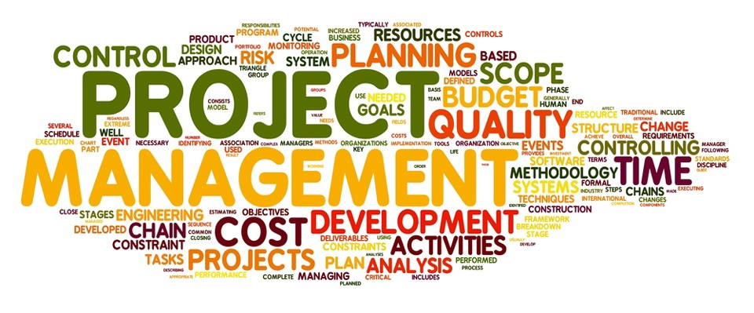
Group 1
Demarey Baker
Hanieh Marvikhorasani
Keyvan Derakhshan Nik

Slide 2
Outline
Project management (What and why)
Project management concepts
Project management activities
Classical project management
Agile project management
Paper : Project Management Success Factors

Slide 3
What is a project?
A temporary endeavor undertaken to create a unique product, service, or result .
-Project Management Institute(PMI)

Slide 4
This is a work product or a group of work products. Work products produced for the customer are also called deliverables.
This is the work to be performed to achieve the outcome. The work is broken down into units of work, which can be tasks or activities. A task is the smallest amount of work that can be managed. Tasks and activities can also be recursively grouped into higher-level activities. Work is described in work packages.
A schedule maps on a timeline the units of work performed to achieve the outcome. Units of work can depend on each other. A schedule has a start, a duration, and an end.
The people (called participants), funds, equipment, and facilities required to perform the work are the project’s resources. People assume one or more roles in the project. Each role is responsible for one or more work packages.
Outcome
Work
Project components
Schedule
Resource

Slide 5
What is Project Management?
The application of knowledge, skills, tools, and techniques to project activities to meet the project requirements.

Slide 6
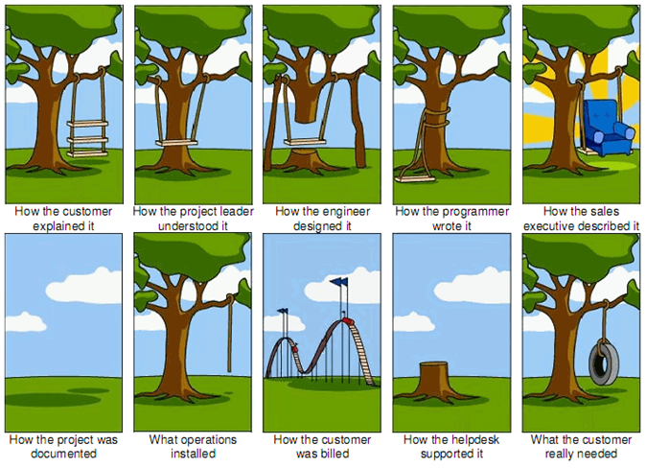
Why project management is important?
Project management ensures the delivery of a quality system on time and within budget;
the essential components of this definition are
Quality
Time
Budget
All three aspects of the project—quality,
budget, and time—are essential for success.

Slide 7
Project management concepts
Tasks and activities
Work products, work packages, and Roles
Work Breakdown Structure
Task Model
Skill Matrix
Software Project Management Plan

Slide 8


A task is a well-defined work assignment for a project participant or a team. A task is the smallest unit of work that is subject to project management.
A task includes a description and a
duration, and is assigned to a role filled by a participant.
Tasks consume resources and produce one or more a work products. They often consume work products produced by other tasks
Activities are larger units of work. Their duration is often the same as a development phase, such as requirements analysis or system design. When activities span the whole duration of a project, they are called project functions. Examples of project functions are configuration management and project management itself.

Slide 9
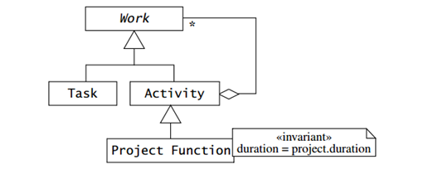
Task, Activities and Project Function (UML Class diagram)

Slide 10
Work products, Work Packages, and Roles
A manager assigns tasks, activities, and project functions to participants or a team, who carry it out, while the manager monitors the progress and completion of the work.
In a small project this can be done informally, often with a shake of hands.
In larger projects, this must be spelled out more explicitly in form of a work package.

Slide 11
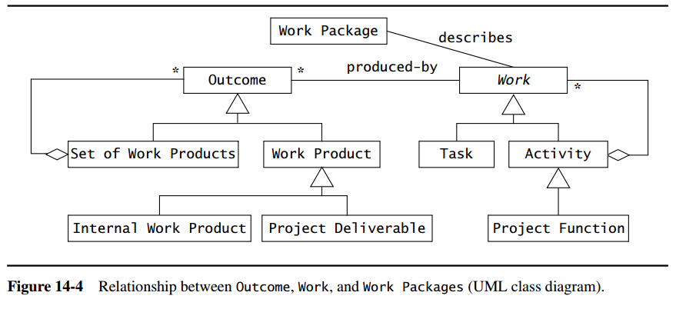
Work Package
A work package describes the
work products to be produced,
the resources needed to perform the work
the expected duration,
dependencies on inputs, which are work products produced by other tasks as well as dependencies on other tasks.
Acceptance criteria
Name of the responsible individual or organizational unit.
Deliverables – work products delivered to the customer
Internal work products

Slide 12
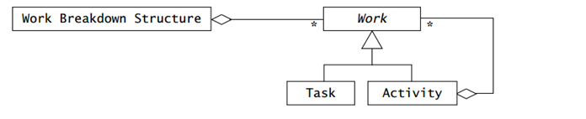
Work breakdown structure (WBS)
The Work Breakdown Structure is the aggregation of all the work to be performed in a project.

Slide 13
Task model
Tasks are related by temporal dependencies. The set of tasks and their dependencies is called the task model or network diagram.
Durations
Critical Path-This is simply the longest path in the task model, called critical path, that proceeds from the first task in the project to the last, where the length of the path is computed by adding the task durations.
The project manager focuses particularly on the tasks on the critical path, as any delay in these tasks results in delays of the overall project and missed deadlines.
A task’s slack time is the maximum amount of time a task can be postponed without delaying the rest of the project.

Slide 14
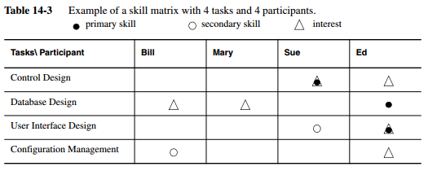
Skill Matrix
A skills matrix is a convenient form of relating the skills, knowledge, and interests of people to the tasks to be performed in the project.

Slide 15
Software project management plan (SPMP)
The audience of the SPMP includes the management and the developers. The SPMP documents all issues related to client requirements (such as deliverables and acceptance criteria),the project goals, the project organization, the division of labor into tasks, and the allocation of resources and responsibilities.
In waterfall projects, this document is created before the project kick-off by the project manager.
In architecture-centric projects, it is created after the software architecture is defined.
In agile projects, this document is updated after each iteration.

Slide 16
Software Project Management Plan (SPMP)
Seven Sections
The first three sections of the SPMP provide background information for the rest for the document. Contains hard constraints from the Project Agreement that are relevant to the developers.
Project organization- communication roles, boundaries of each team and management, responsibilities assigned
Managerial process plans- project initiation, steady state, and termination, and how it addresses unforeseen problems.
Technical process plans, describes the technical standards that all teams are required to adopt.
Supporting process plans, includes provisions for each of the supporting processes, such as configuration management, verification and validation, documentation, quality assurance, reviews and audits, problem reporting, subcontractor management, and process improvement.

Slide 17
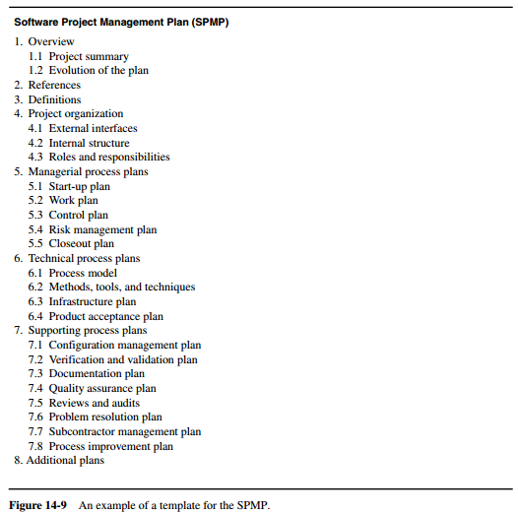
Software project management plan (SPMP)
The completed SPMP document should be reviewed both by management and by developers to ensure that the plans are feasible and realized in the project.

Slide 18
Project Management Activities
Planning
Organizing
Controlling
Terminating

Slide 19
Classical Project Management
In classical projects, in the scope of the product is relatively well defined at the beginning of the project and the goal of the project is to deliver within a specific deadline and budget.

Slide 20
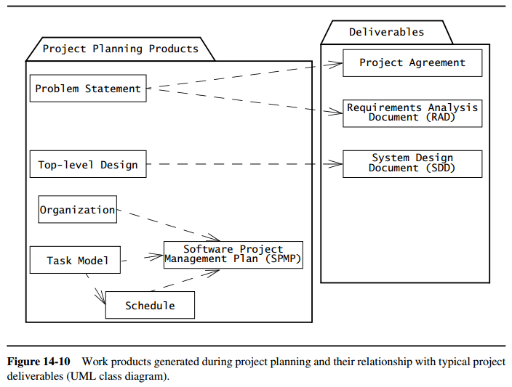
Classical Project Management-Planning
Defining the problem
Identifying the initial task models and organizing structure
Estimating needed resources such as personnel and funding

Slide 21
Classical Project Management-Organizing
Setting up the communication infrastructure
Identifying skills
Assigning management roles
Assigning technical roles
Dealing with skill shortages
Selecting team sizes
Assembling the teams
Kick-off-meetings
Agreeing on the project scope

Slide 22
Classical Project Management-Controlling
What is controlling?
Collecting accurate status information in order to make effective decisions in the steady state phase of the project.
Tools to collect status information :
Meetings
Metrics A combination of these should be used
Managing risk

Slide 23
Controlling the project- Meetings
Meeting | Advantages | Disadvantages
Periodic status meetings | Best potential for reporting | Inaccurate information if team members not cooperate
Sharp milestones | Good if sharp mile stones are defined | Bad mile stone: “coding completed”
Project reviews | Good if participants exchange status | If participants are reluctant to admit problems
Code inspections | Effective method for discovering defects early | -
Prototype demonstrations | Good for measuring initial progress | Do not illustrate how borderline cases are dealt with or how robust the implementation is

Slide 24
Controlling the project- Metrics
Why we need metrics in addition to meetings?
Meetings are rely on the perception of selected participants and their willingness to communicate what they know.
What are software metrics?
Quantitative measures of selected aspects of the progress or the system.
Metrics can measure attributes of the progress such as deviation with the schedule, resources expanded, and number of participants leaving prematurely.

Slide 25
Classical Project Management-Metrics
Measuring financial status: comparing planned costs against actual costs.
Measuring technical progress: Size metrics for each team
Measuring stability: Measuring the rate of change requests
Measuring modularity: Measuring breakage
Measuring maturity:

Slide 26
Controlling the project- Risk management
What is Risk Management?
Identify possible problems in the project and address them before they can significantly affect the delivery date of budget.
Why Risk Management?
Many project fail either because simple problems we reported too late or because the wrong problem was addressed.
Key element of Risk Management :
Setting up appropriate information flows such that risks and problems are accurately reported in a timely manner.
Risk management activities:
Identifying risks
Analyzing risks
Addressing risks

Slide 27
Risk Management- Identifying risks
First step of risk management is identifying risks
Risks : Potential problems that result from an area of uncertainty.
Managerial
Include any uncertainty related to the organization, work products, role, or task plans
Include any uncertainty related to the system models, including changes of the functionality of the system, the nonfunctional requirements, the architecture, or the implementation of the system(defects discovered late in the development).
Risks
Technical

Slide 28
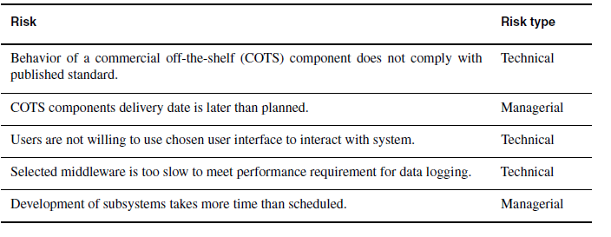
Example of risks identified in the OWL project

Slide 29
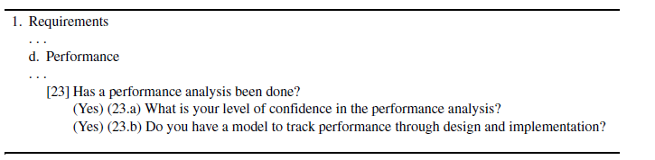
Identifying risks: Questionnaire
Questions for eliciting performance risks in the Taxonomy-Based Risk Identification process. If the question to question 23 is positive, questions 23.a and 23.b are asked of the developers.

Slide 30
Prioritizing risks
Prioritizing risks allows managers to focus on the critical risks
Likely, high potential impact
Developers and managers should draw contingency plans and monitor the risk carefully.
Unlikely, high potential impact
Managers should monitor these risks , no contingency plan is needed.
Likely, low potential impact
Can be ignored
Unlikely, low potential impact
Can be ignored

Slide 31
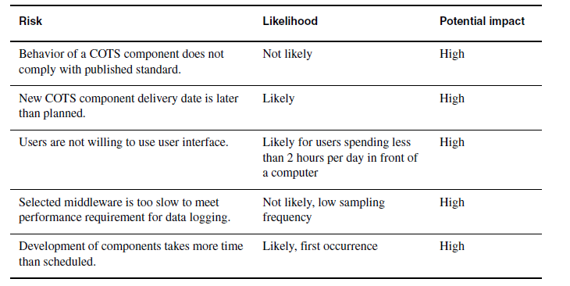
Prioritized risks for a project

Slide 32
Risk management- Addressing risks
Once risk are identified and prioritize :
Mitigation strategies should be designed for critical risks
mitigation strategies include lowering the likelihood of the risk or decreasing it potential impact
Developers decreases the likelihood of the risk by:
Further investigating the causes of the risk
Changing suppliers or components
Selecting redundant supplier or component
Developers decreases the impact of risks on the project by:
Developing and alternative or redundant solution.

Slide 33
Classical Project Management-Terminating the project
Accepting the system
Installation
Postmortem

Slide 34
Agile project management activities

Slide 35
Agile approach
Classical approach
Classical
VS
Agile
Ill-defined requirements
Emerging solution technologies
Changes are addressed by focusing on small product increments.
Well-defined requirements
Repeatable and predictable processes (Mature Technologies)
Change is controlled and even discouraged.

Slide 36
Scrum ( Example of Agile project management method)
Sprints:
The Scrum approach is characterized by short iterations, called sprints, during which a release candidate is developed.
This is also called potentially deliverable product increment.

Slide 37

Planning the project (Scrum) - Product backlog
Project kick off meeting
Product owner and Scrum master brain storm first version of requirements
Product backlog
Requirement 1
Requirement 2
Requirement 3

Slide 38
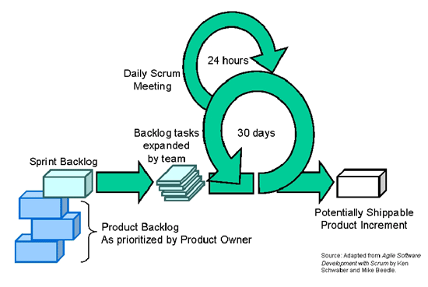
Planning the project (Scrum) - Sprint backlog
Sprint planning meeting
Product backlog
Requirement 1
Requirement 2
Requirement 3

Slide 39
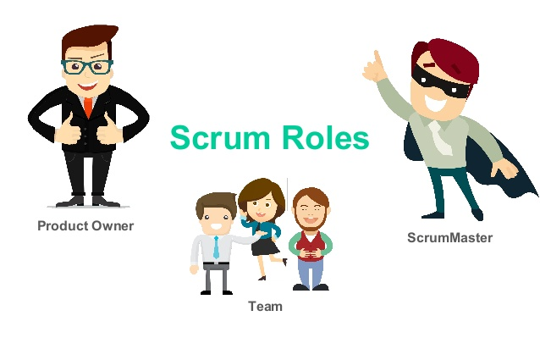
Organizing the project(Scrum) - Scrum Roles

Slide 40

Scrum Roles-Product owner
Hello I am Product Owner !
The most important part of scrum!
Responsible for the requirements
Participation in product backlog before each sprint.
Represents the client and user with a single voice.
Changes and re-prioritizes the product backlog before and after each sprint to reflect lesson learned.
Solely responsible for the product backlog and has no influence on the team during the sprint.

Slide 41

Scrum roles-Scrum Master
I am the Scrum Master !
Management role responsible for the process
Sets up and enforces the rules and practices of the project
Facilitates daily Scrum meetings, monitor progress and removes obstacles.
Interface between Scrum team and product owner.
Ensure team productivity, and shields the team from distractions.

Slide 42

Scrum roles- Scrum Team
We are Scrum Team !
Developing the product increment
Cross functional
Self organizing
No assigned role or job description
Participating in sprint planning meeting
Committing to the tasks defined in the sprint backlog

Slide 43
Controlling the project
Scrum Master monitors the progress of Project with :
Daily Scrum meetings
Burn Down Charts

Slide 44
Controlling the project - Daily Scrum meeting
Short-term review of the Sprint

Slide 45
Controlling the project(Scrum)-Daily Scrum meeting
Scrum master identifies following actions:
Each member team reports individually:
Status: Work done since the last daily Scrum meeting
New issues: Obstacles that are preventing them to accomplish their work
Sew action items: Work promised for the rest of the day
Planning new work that was not identified in the sprint planning meeting or in the previous daily Scrum meetings
Reallocation of tasks between members due to mismatch of skills or lack of interest
Removing obstacles

Slide 46
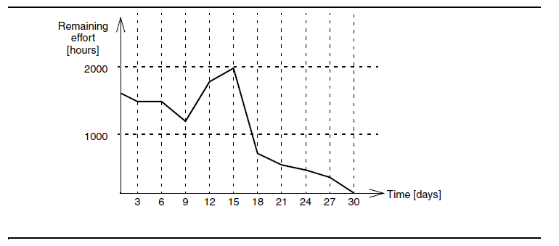
Controlling the project(Scrum)-Burn Down Chart
depicts the estimated remaining effort as a function of time
Scrum master use it for:
Review progress
Assess trends

Slide 47
Terminating the project-Sprint reviews
Management may adjust team decomposition.
Product owner may change requirements base on past team performance
Sprint may be terminated if the goals of sprint is not reachable
Product owner negotiate the product backlog with the client
Product owner may propose or revise specific requirements or assign new priorities
Product owner may propose to revise specific requirements or assign new priorities.
Product owner may propose a release schedule or change the allocation of requirements to releases( based on the performance of the team)

Slide 48
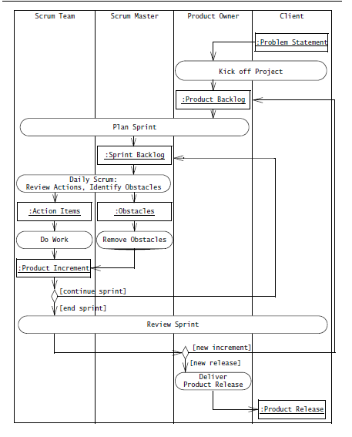
Overview of a Scrum process

Slide 49
Paper : Project Management Success Factors

Slide 50
Paper : Project Management Success Factors
What is the “success” in Project Management?
How we can determine project success?
project success?
project management success?
Although there is no consensus definition of what project success consists of ,authors are agreed that project success can be achieved through good actions of project manager.
Construction projects success is one of the famous and important successes.
It is hard to make a strong differentiation between them because:
1- existence of many different models of both .
2- mostly because of their mutual relationships.

Slide 51
Project Management & Project Goals
Project management is:
planning,
organization,
monitoring and control of all aspects of project,
with motivation of all included to achieve project goals.
Project goals:
- on safe manner,
- within agreed schedule,
- within agreed budget,
- within agreed performance criteria .

Slide 52
Project Management & Project Goals-Cont’d
Namely, project can be successful despite unsuccessful project management because it has achieved higher and long-term goals.
Sometime the management of project stops, short-term orientation can be unsuccessful, but long-term outcome can be successful, because wider set of goals are satisfied, instead of narrow subset which project management consists of.
The project main subjects are:
time,
cost,
quality.

Slide 53
Project Management & Project Goals -Cont’d
The “iron triangle” model itself was the very first model of project management success.
Besides the “iron triangle”, and taking into account considerations of project management success, it is possible to find many different approaches:
integration,
scope,
human resource,
communication,
risk
procurement management.

Slide 54
How to measure if project management is successful?
Project management success can be evaluated through
already mentioned criteria of :
But:
time,
cost,
quality,
scope,
resource
activity
models of measuring success like PMPA – Project Management Performance Assessment
maturity models of management within organization like Project Excellence Model.
It is hard to answer the question of project management success evaluation precisely, because project management creates both tangible and intangible benefits
Project management success is one of the elements of project success, because the latter is hardly achievable without it

Slide 55
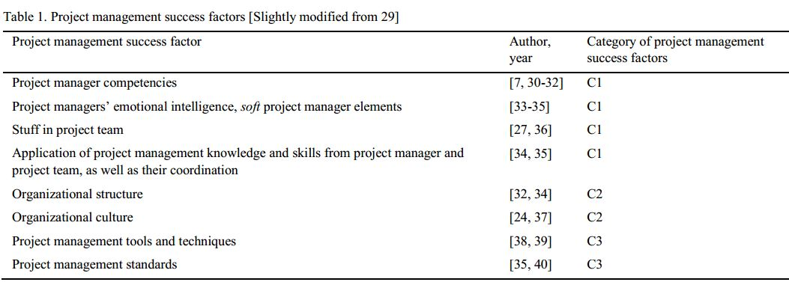
Project Management Parts
Elements of project management competence (C1)
Elements of organization (C2)
Elements of project management methodologies, methods, tools and techniques (C3)

Slide 56
Project Management Parts- Cont’d
First category, elements of project management competence, consists of
technical of project manager and project team members,
behavioral of project manager and project team members,
contextual competencies of project manager and project team members,
coordination between project manager and project team members.
Second category, elements of organization, consists of:
organizational structure,
organizational culture,
organizational atmosphere,
organization competence.
Third category consists of :
project management methodologies,
project management software,
project management tools,
decision-making techniques,
risk assessment tools
information communication technology support tools.

Slide 57
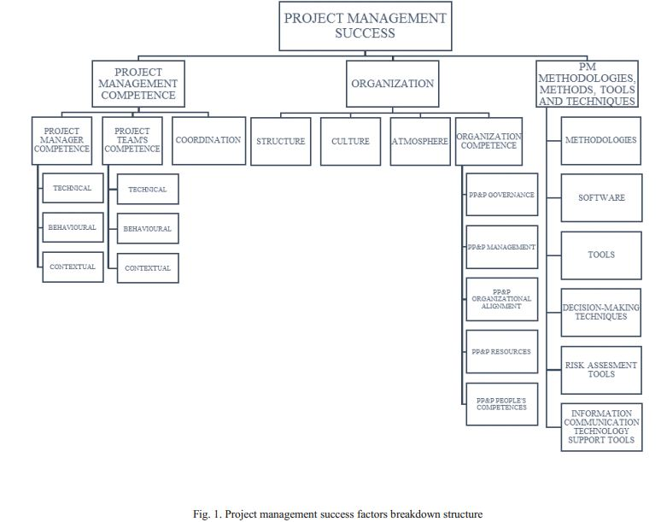
PP&P: Public-Private and Partnership

Slide 58
EU co-financed water projects: case study
EU co-financed water projects are public projects in the Republic of Croatia, which are being planned, selected, verified, monitored and controlled under Croatian water.
The fact that these projects are public, gives special accent on their project management. Project manager must take into consideration a larger scope of elements than time, cost and quality while taking managerial decisions – e.g. end users satisfaction, environment, health and safety, political and social implications etc.
Factors from the three categories will be tested on three case studies can be seen in table 2.

Slide 59
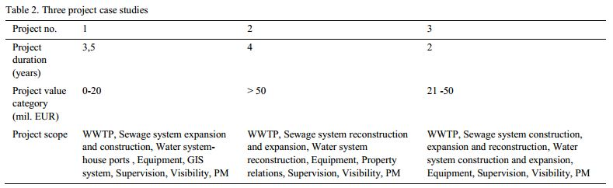
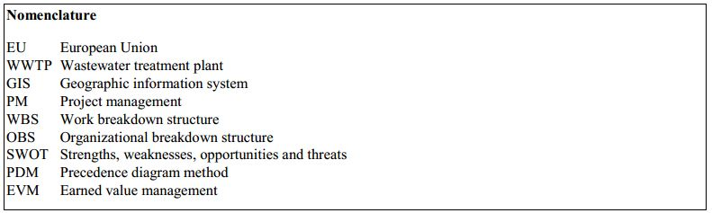
Project managers were asked to assess
the strength of project management competence (on Likert scale 1-5; where 1 = insufficient competence, 2 = sufficient competence, 3 = good competence, 4 = very good competence, 5 = excellent competence).
existence of organization competence, define parent organizations’ structure, culture and atmosphere.
name those project management methodologies, software, tools and techniques in use.

Slide 60
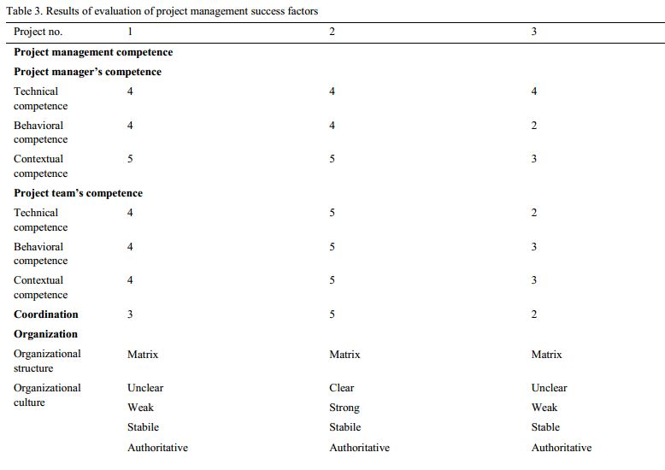
The result of project reviews and interviews with project managers are shown in table 3

Slide 61
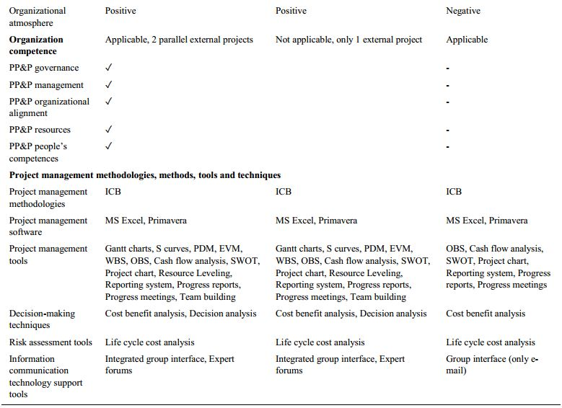

Slide 62
Summary of Table 3
Project managers on projects 1 and 2 are quite competent, especially in contextual sense.
Project team’s competence on second project is excellent. Team members’ competence on the first project is very good and on the third project, very low.
Coordination between project manager and project team is extremely highly assessed on the second project, good on the first project and bad on the third one.
All parent organizations have matrix structure, what means that some project team members work both on project and in their regular departments of functional part of organization.
Speaking of organizational culture, it is stable in sense of years and tradition on operating on one way, but is strong and clear only on the second project.

Slide 63
Organizational atmosphere is negative only on the third project, which is not surprising according to the previous notions on that project.
It is useful and purposeful to analyze organization competence only in those organizations that manage more than one project at the time, what is the case on the first and third project.
All elements of organization competence do exist on the first project, but not on the third one.
When it comes to the last category, it can be noted that first and second project are keen of usage of same project management methodologies, methods, tools and techniques. Third project, on contrary, uses only those tools that are obligatory on EU co-financed projects in water sector such as cost benefit analysis.
To conclude, second project has the most successful project management, the average one is on the first project and the worst on the third one.

Slide 64
Future PM development consist of:
Education. Education on PM competence and even more important
Relationship between project and parent organization.
PM methodologies, methods, tools and techniques.

Slide 65
Conclusion :
Project management is inevitable in today’s world
Project management is not only necessity for that improvement but also one field that seeks for improvement itself.
The project management success factors breakdown structure is illustrated.
Investments in project management field should be made, especially through strengthening people and organization competence.

Slide 66
References:
Book: Software Engineering Using UML Patterns and Java, 3rd edition. By Bernd Bruegge & Allen H. Dutoit
Paper: Project Management Success Factors, By Mladen Radujkovića, Mariela Sjekavicab, Creative Construction Conference 2017, CCC 2017, 19-22 June 2017, Primosten, Croatia

Slide 67

Questions?

